Slide 1

Information and Communication Technologies

Slide 2


Introduction
Information and Communication Technologies (ICT) encompass a broad range of technologies that facilitate the gathering, processing, storage, transmission, and dissemination of information. This includes telecommunications, computing, internet technologies, and multimedia.

Slide 3



Evolution Of ICT
ICT has evolved significantly over the years, from the invention of the telegraph to the development of the internet and beyond.
Key milestones include the advent of personal computers, the rise of the World Wide Web, and the proliferation of mobile devices.

Slide 4


Future Trends in ICT
-Integration of AI and ML in various applications.
Automation and intelligent decision-making.
-Enhanced connectivity and faster data transfer.
Support for emerging technologies like IoT.
-Potential for solving complex problems efficiently.
-Advances in cryptography and data processing.
-Decentralized data processing closer to the source.
-Reduced latency and improved efficiency.

Slide 5



Impact Of ICT
-Facilitation of global trade and commerce.
-Job creation and the emergence of new industries.
-Improved communication and connectivity.
-Enhanced access to information and education.
-Advancements in medical technology.
-Telemedicine and remote patient monitoring.

Slide 6




ICT Tools
technological landscape of Information and Communication Technologies (TIC), focusing on key tools and platforms, including Google services, Microsoft tools, Git, and GitHub. Google's suite of services

Slide 7









Google Services And Google Cloud
Collaboration tools like Google Docs, Sheets, and Slides.
Communication solutions with Gmail, Google Meet, and Google Chat.
Cloud-based storage and sharing through Google Drive.
Infrastructure and data storage solutions.
Machine learning and artificial intelligence services.
Application development and deployment tools.

Slide 8






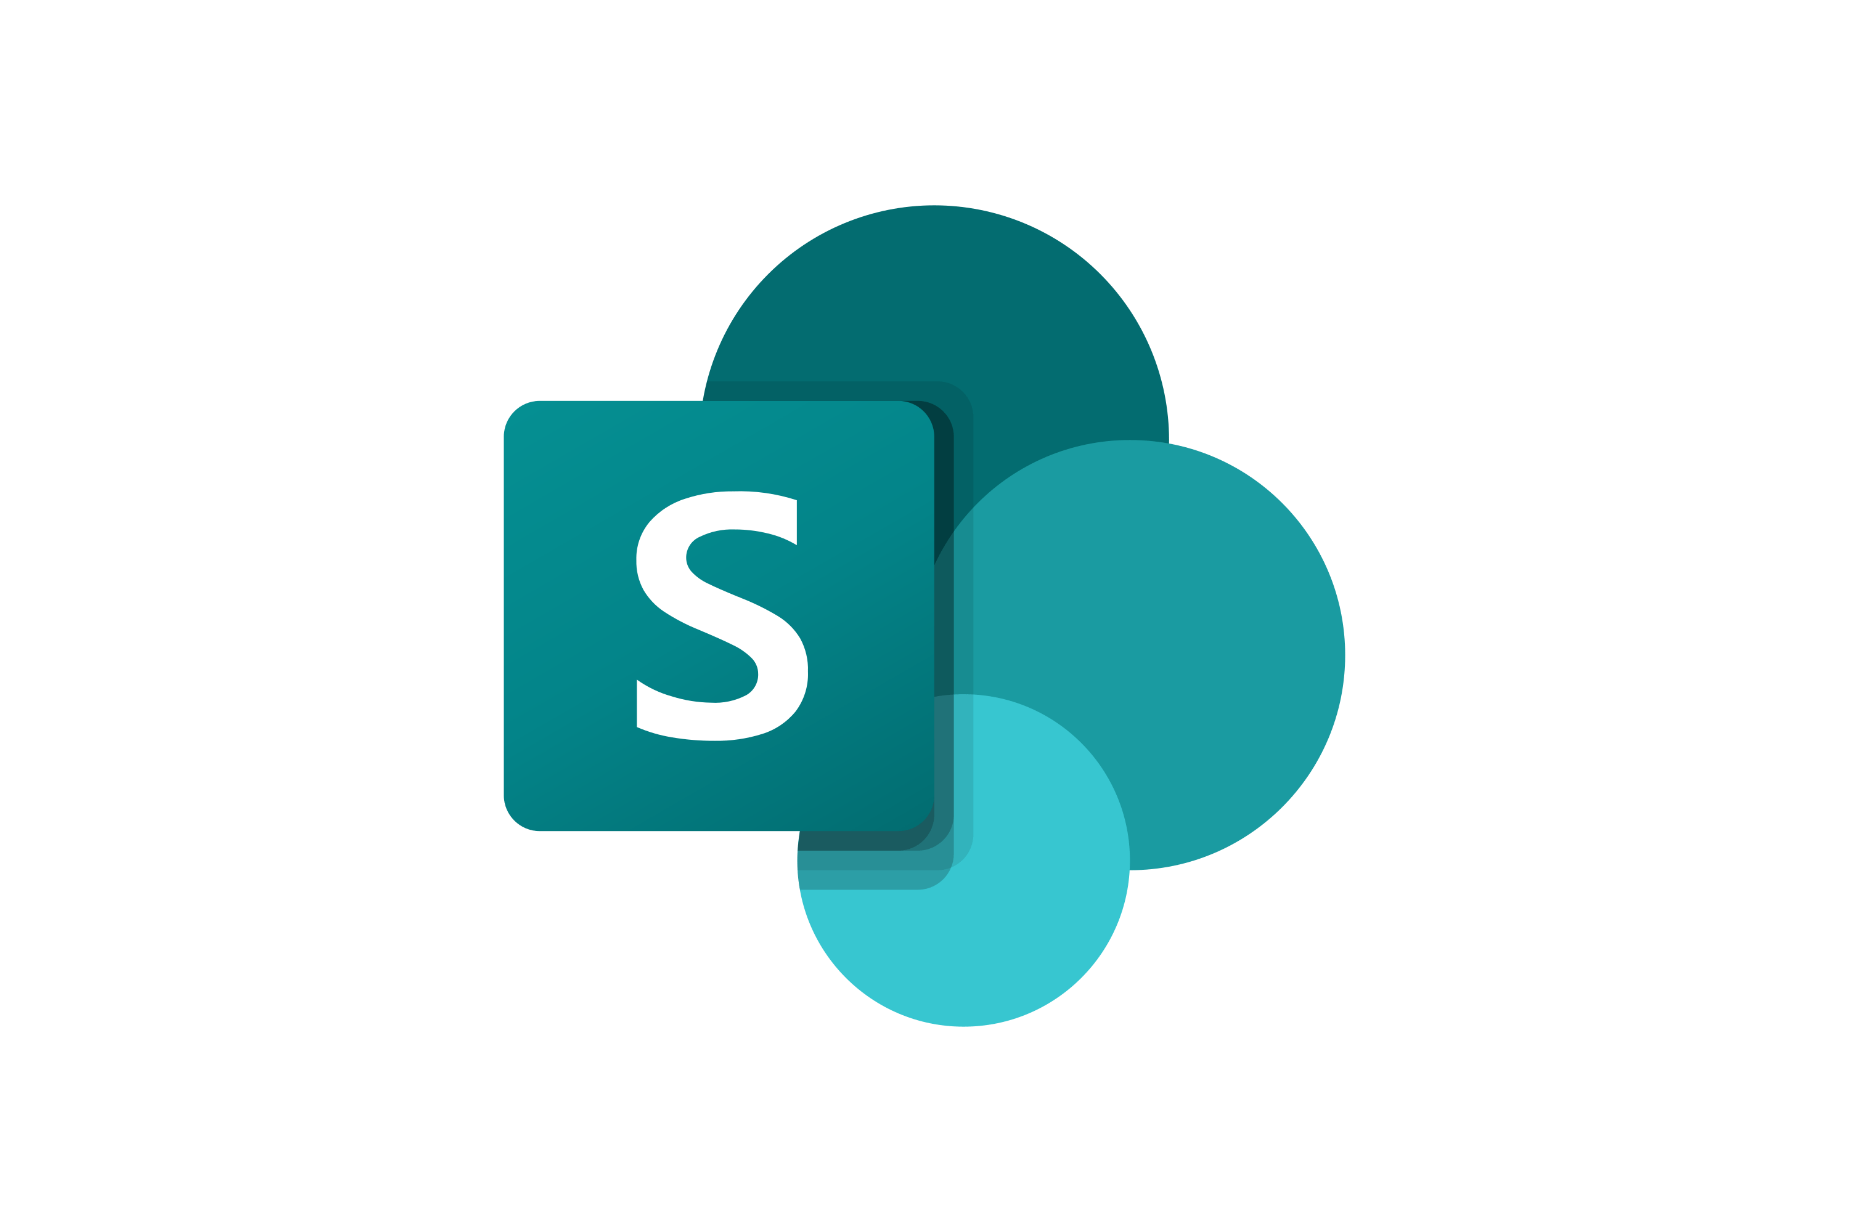
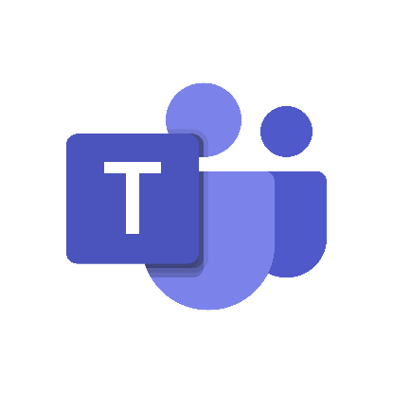
Microsoft Services
Productivity tools, including Word, Excel, and PowerPoint.
Collaboration platforms with Teams and SharePoint.
Cloud-based storage and file sharing through OneDrive.
Cloud computing services for infrastructure, platform, and software.
Azure DevOps for application development and lifecycle management.
AI and machine learning capabilities

Slide 9

Git And GitHub
Distributed version control system for tracking changes in source code.
Enables collaboration among developers.
Branching and merging features for efficient code management.
Web-based platform for hosting and collaborating on Git repositories.
Issue tracking, pull requests, and code review functionalities.
Widely used in open-source projects and enterprise software development.

Slide 10

Google,Git and Microsoft Integration
Integration of Google services with Microsoft tools for seamless collaboration.
Compatibility between G Suite and Microsoft 365 for enhanced productivity.
Git integration with development environments and IDEs.
GitHub Actions for automating workflows and continuous integration.

Slide 11








Impact on Software Development
Collaboration and Efficiency :
-Google and Microsoft tools streamline communication and collaboration.
-Git and GitHub enhance version control, code review, and collaboration in software development.
Innovation and Flexibility :
-Leveraging cloud services from Google and Microsoft accelerates innovation.
-Git and GitHub support agile development methodologies and foster open-source contributions.

Slide 12

Conclusion
Information and Communication Technologies have become an integral part of our daily lives, influencing how we communicate, work, learn, and access information. While presenting numerous opportunities, the rapid pace of technological advancements also poses challenges that require careful consideration. The ongoing evolution of ICT promises to shape the future of societies, economies, and industries, with the potential for further transformative impacts
-The technologies associated with TIC, including Google services, Microsoft tools, Git, and GitHub, collectively shape the contemporary landscape of information, communication, and software development.
-The seamless integration and interoperability of these platforms contribute to enhanced collaboration, innovation, and efficiency across various sectors,

Slide 13
Project By
Belaidi Ramzy Zakaria
BELHADJ Ahmed Amine
Benaziza Malak
Zerrouki Alaa
Afra Wafa

